Slide 1


AGENTIC AI
Capstone Project 1 - Content Blitz
Presented by Saraniya Dhansekaran

Slide 2

System Design
The Agentic AI system architecture comprises several core components:
Streamlit as the primary user interface and orchestrator
Agents involved include:
router_agent
python_agent
general_agent
social_media_agent
image_prompt_agent
image_creation_agent
CrewAI - Agent orchestration efficiently manages different task stages
OpenAI integration for text generation (gpt-4o-mini) and image generation (gpt-image-1)
System setup requires configuring the OPENAI_API_KEY environment variable

Slide 3
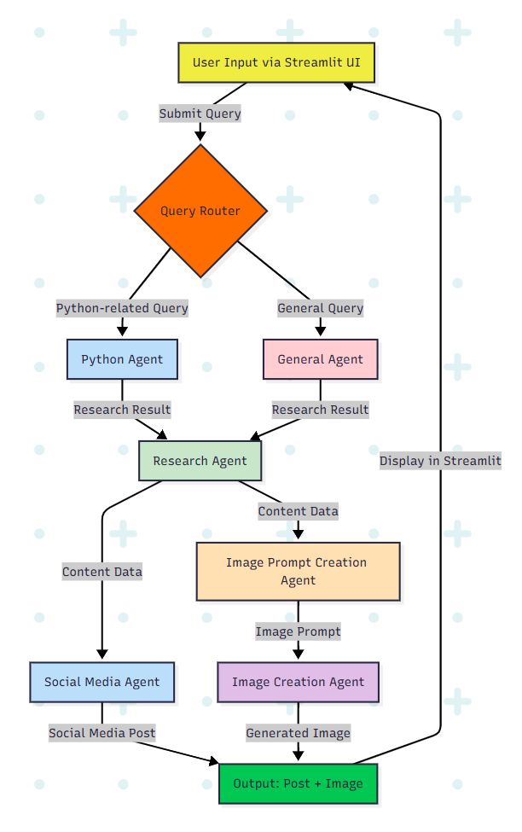
User Workflow Diagram
Visualizing AI Agent Interactions
This diagram illustrates the seamless flow of user inputs through various agents, showcasing how each component contributes to generating comprehensive answers and content, enhancing user experience and efficiency.

Slide 4
Technologies Used
Programming Language
The project is developed using Python 3.11, ensuring compatibility with various libraries and providing a robust environment for AI implementations.
Key tools and frameworks for Agentic AI project
Frameworks & Libraries
Core technologies include Streamlit, CrewAI, and LangChain, which facilitate seamless integration of AI functionalities and enhance the user experience.
Containerization
Docker is employed for containerization, allowing easy deployment and management of the application across different environments while ensuring consistent performance.

Slide 5

Any questions about the project
?

